Slide 1
Cadence Walkthroughs

Slide 2
Agenda
How to create a Partner in CADENCE and print out screening evidence for FinCA
Sample of CADENCE Screening Evidence
How to search for an existing partner in CADENCE
How to cancel a terminated partner in CADENCE
How to request user access to CADENCE
How to request a PARTNER list export report from CADENCE
Sample of Bridger Screening Evidence (only for emergencies)

Slide 3
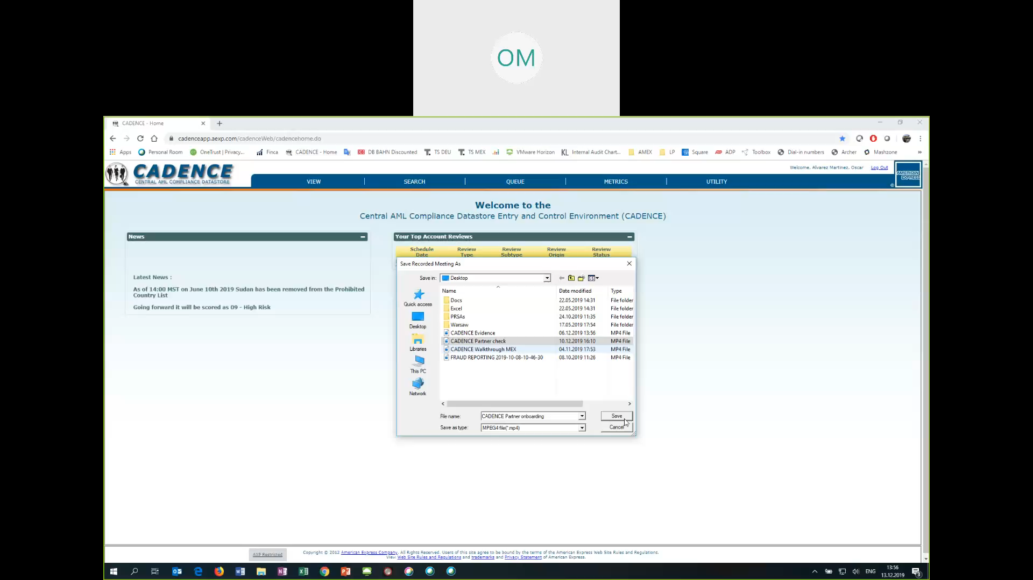
Video
Click Play
PAYBACK Partner creation + FINCA Evidence PDF Print out – Instruction Video

Slide 4
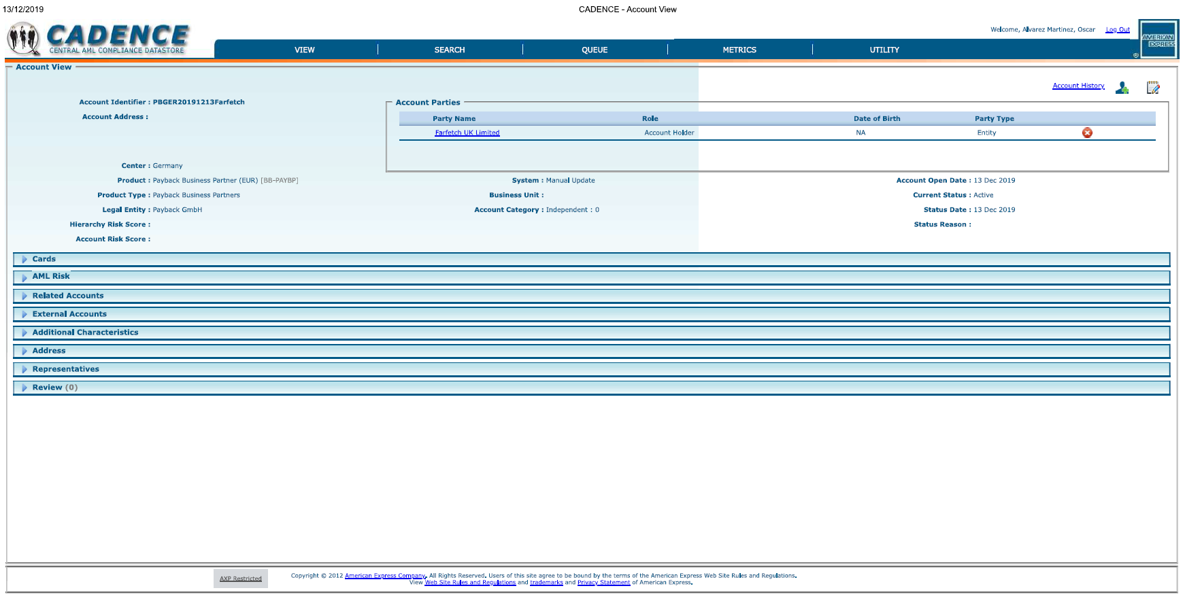
Sample of CADENCE Screening Evidence
Date chosen when creating the record
Date of record entered in CADENCE

Slide 5

How to search for a partner? by Account Identifier (View tab) recommended. or by Legal Entity name (Search tab)
Video
Click Play
Search Recommended: Account identifier will deliver an exact match as this is a unique ID.
Legal entity name might have several records as there are various AMEX groups adding parties to CADENCE and it would be hard to identify the one set up by Payback and/or whether is in active status. If there is only 1 record then it is easy to find.

Slide 6
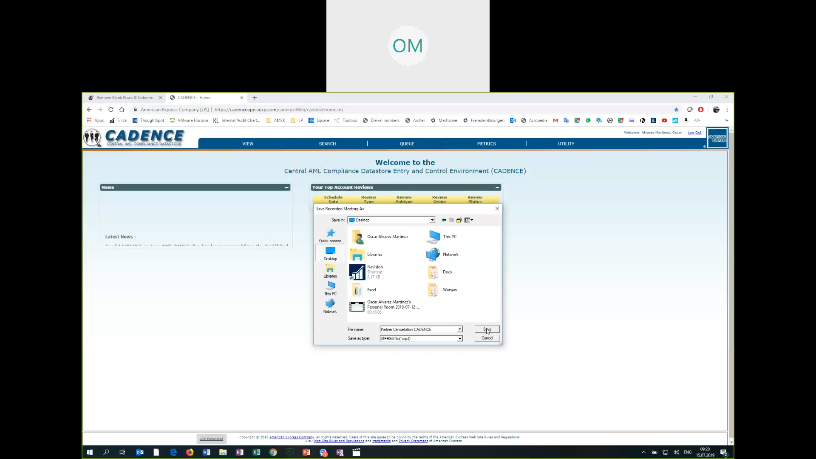
Video
Click Play
PAYBACK Partner cancellation – Instruction Video

Slide 7
Video
Click Play
Search a partner and print-out evidence to PDF for FINCA

Slide 8
CADENCE user access request
Training confirmation on use of CADENCE is required before granting access
ADS credentials / contractor ID needed
Access request form send to CADENCE <CADENCE@aexp.com>:

Slide 9
CADENCE extract report and control check
CADENCE does not offer a full list view of existing partners nor a possibility of extracting such a list directly from the tool. For that we need to request an extract report via the CADENCE team by submitting the following form:
The Operational Excellence team at payback requests the report in a quarterly basis to monitor that all entries in CADENCE are also in NAVISION by partnering with the acquisition team.

Slide 10
Appendix

Slide 11
Sample of Bridger Screening Evidence (only for emergencies)

