Slide 1
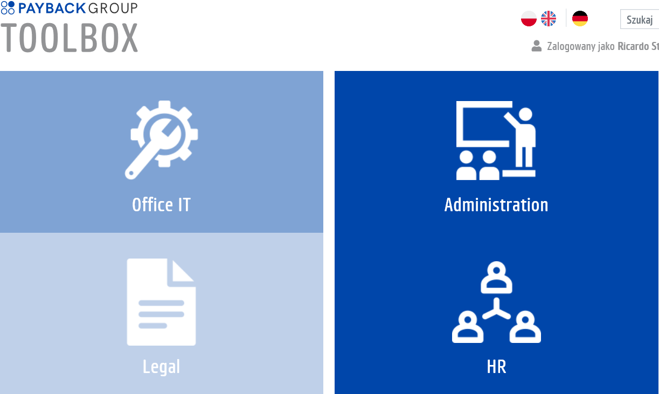

INDUCTION IT
interaktive
Choose Reading View
or Slide Show

Slide 2



Legend
1
First steps
The traffic lights and arrows
2
Software
3
Necessary steps
Helpdesk
4
Optional steps with arrow and go to next
Hardware
5
Read the slide and
go to the next one
Office
6
Your data
show you the way

Slide 3

First steps
1
First login to
Windows (1), Microsoft (2), Global Protect (3), Amex Square (4)
(1) Jan Kowalski: login: jkowalski (external: jkowalski_ext)
  New password contains at least 8 signs, a capital and small sign and a number
(2) login: first.secondname@payback.net
  Password as in (1)
  (external: first.secondname_ext@payback.net)
(3) login: jkowalski password: pin + token (RSA SecurID softtoken)
The password (1, 4) need to be changed after 3 month – there will be a reminder by mail

Slide 4
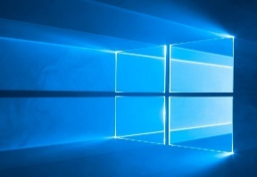
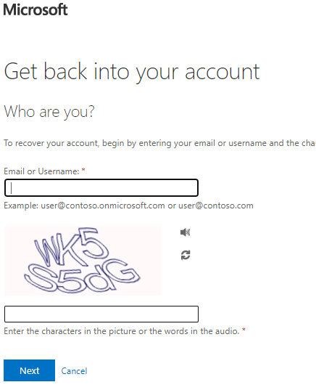
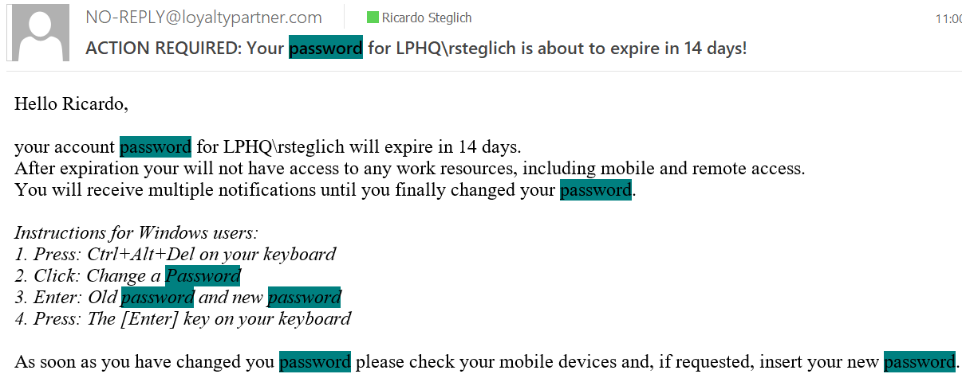
Windows (1)
1
Mail about the password reset:
On homeoffice please first login
with VPN
You do not know your password:
  https://passwordreset.microsoftonline.com/
  Verification with Microsoft (2)

Slide 5
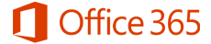
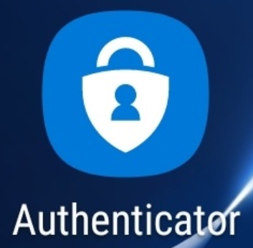
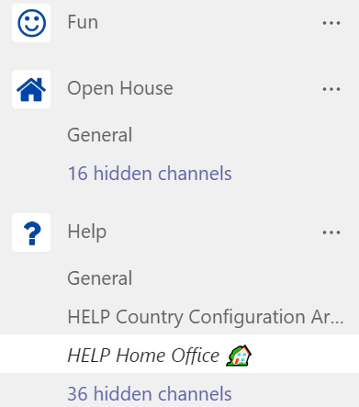
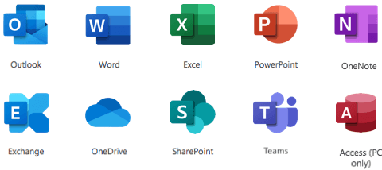
Microsoft (2)
1
Set first the authentication with
  Microsoft Authenticator App and
  Telefone number (of the company or private one)
  Needed for any change of the account settings
Login To Microsoft 365 The Very First Time - OIT Knowledge Base - PAYBACK Confluence (loyaltypartner.com)
Microsoft Office Home
Microsoft Authenticator – Securely Access & Manage Your Online Accounts

Slide 6


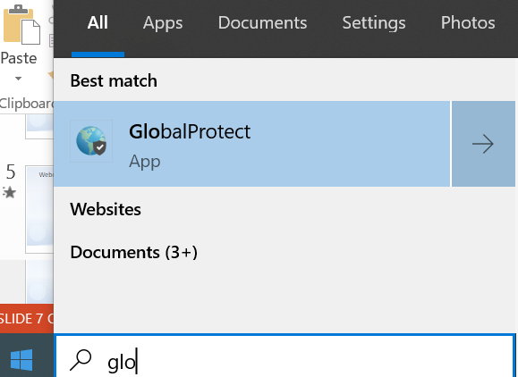

Global protect (3)
1
In the office connected with Lan-cable: loyaltypartner.com
In the office Wifi for laptops: IWL
Outside the office (Wifi, Hotspot or kabel) connect to VPN
Global protect
To login
Order a token
Install RSASecurID
on a mobile phone
Login for the first time
and set PIN
https://muc-rsa-05.loyaltypartner.com:7004/console-selfservice/SelfService.do

Slide 7

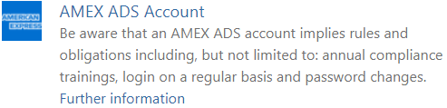
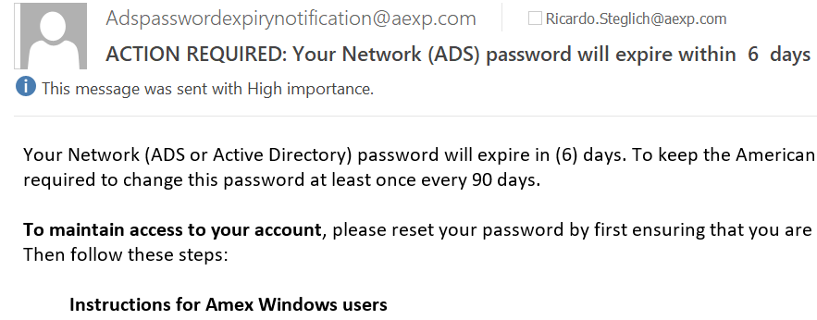
Amex SQUARE (4)
1
Create an account:
  Account creation takes
  about 2 – 3 weeks
  Mails get automatically directed from @aexp.com to @payback.net
The password can only be
changed with citrix
Necessary trainings:
https://amex.csod.com/
Main page SQUARE:
https://square.americanexpress.com/
https://citrix.intra.aexp.com/Citrix/XenApp/auth/login.aspx (citrix)
0044 2035644412 (Amex Hotline)
http://techcare.aexp.com/ (Amex Helpdesk)

Slide 8

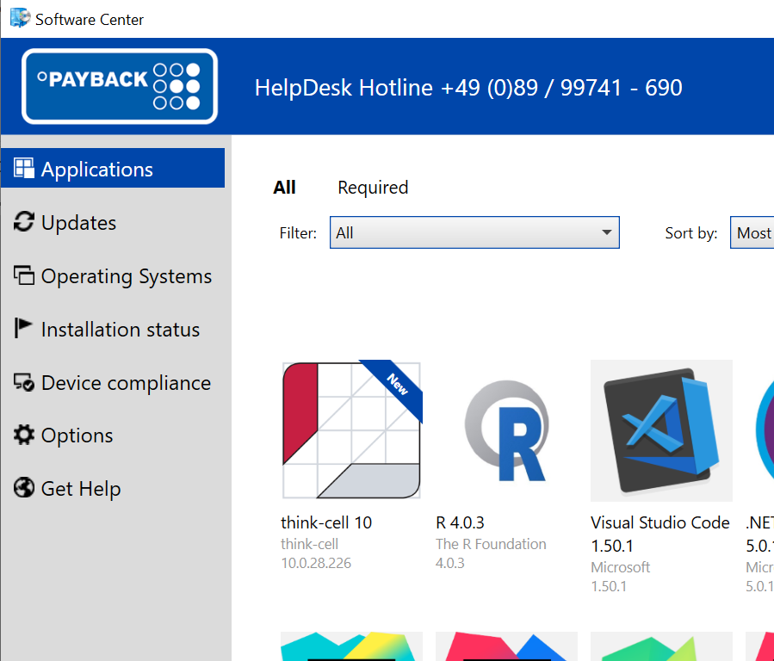
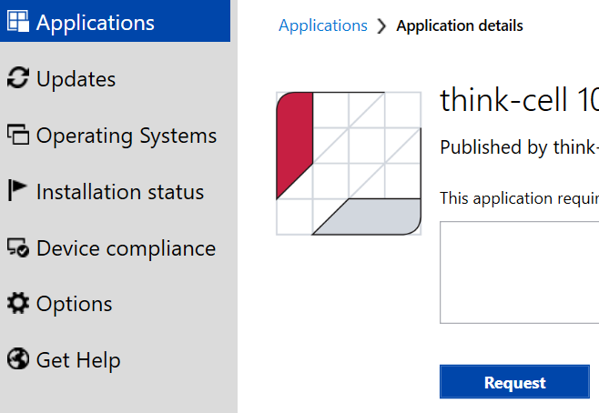
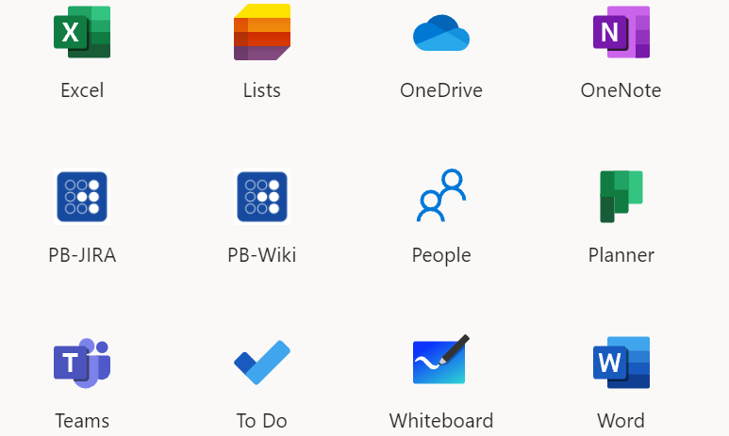
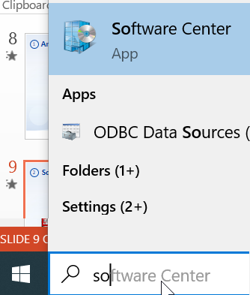
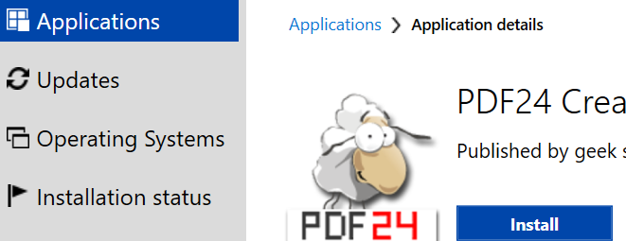

Software Center
2
tool to install additional applications, updates etc.
Applications outside the SC need to be ordered on helpdesk webside (Get Help)
M365
Adobe
Lisence/account from team manager
Password to install from IT
SREQ - Service Desk (loyaltypartner.com)

Slide 9
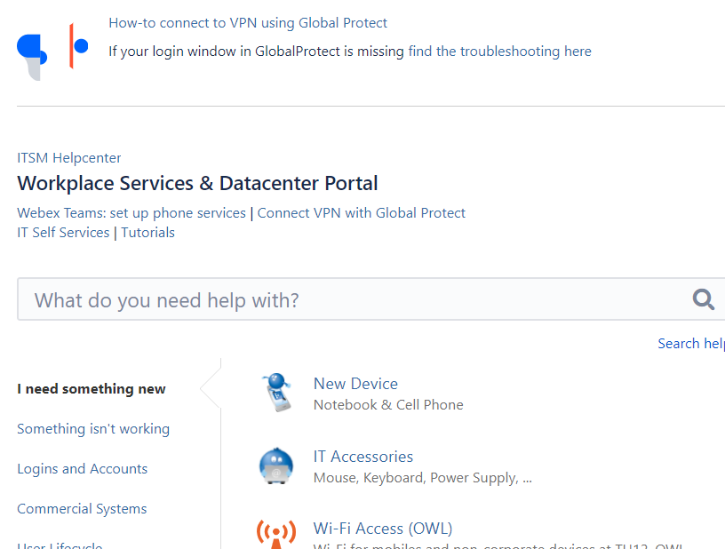





Helpdesk
3
Request
Baza wiedzy
Issue
Here we write only
in English!
1690 lub +49 89 9974 1690 (HelpDesk)
411 or 690115156 (Ricardo Steglich)
https://pb-itsm.intra.loyaltypartner.com/servicedesk/customer/portal/2

Slide 10
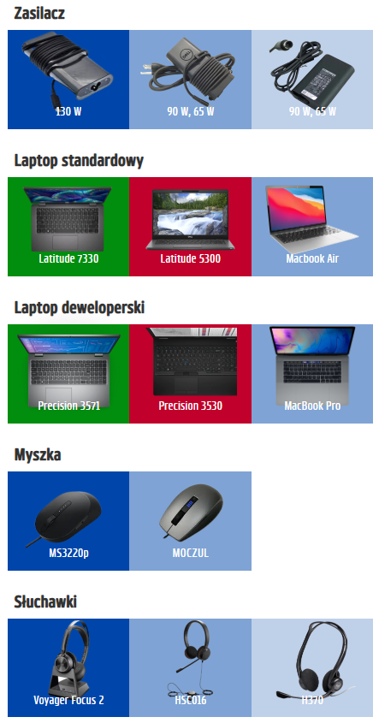
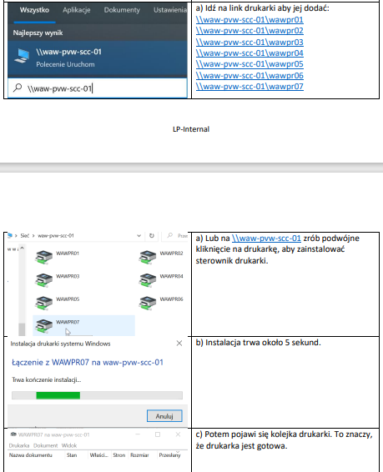
Hardware in the office and at home
4
Loyalty Partner Toolbox: Devices to work
Printer_how_to_use_for_the_first_time.pdf (loyaltypartner.com)

Slide 11
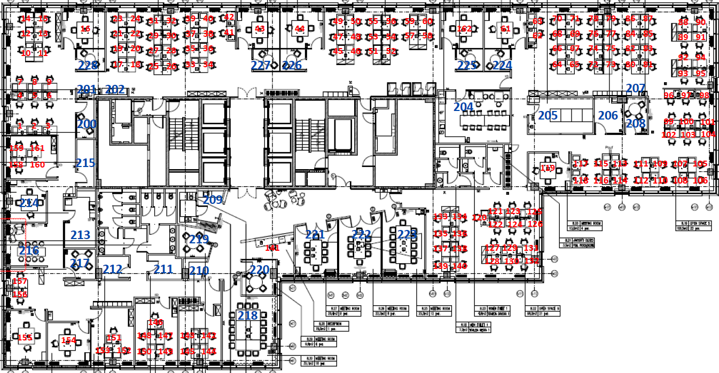
The office
5
IT devices
IT & Dev, Analytics
Adm, Acc, Law, HR
Business, Partners
https://pb-it-services.intra.loyaltypartner.com/ (please register your stay in the office in pandemic times)
https://toolbox.loyaltypartner.com/index.php?id=1582 (how to book a conference room)

Slide 12

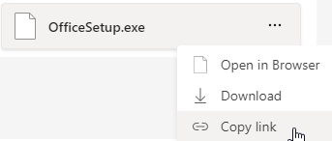
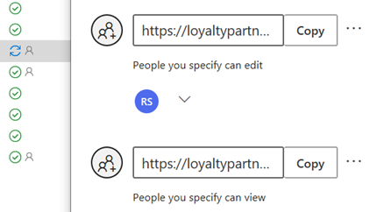

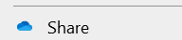

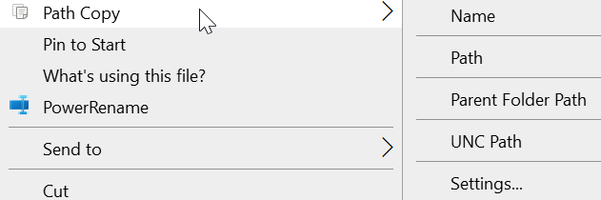

Your data: Cloud vs Server
6
My account (office.com) Microsoft profile
https://webmail.loyaltypartner.com/owa Outlook Web App
Hub - Loyalty Partner Group - Home (sharepoint.com) Sharepoint
One Mail can have maximum 30 MB
https://muc-pvw-hrm-03.loyaltypartner.com/insight Perbit
\\waw-file-01, \\MUC-PVW-FILE-11 P:, Y:
https://moveit.loyaltypartner.com/ MoveIT
USB ports are blocked for saving

Slide 13
Thank you for your attention!
Jacek Dziemian
jacek.dziemian@payback.net
+48 690 115 115
Rafał Kubuj
rafal.kubuj@payback.net
+48 690 115 174
Summary

