Slide 1


Creating EPRs and Orders
Q&A

Slide 2

Agenda 1/2
1
What is EPR versus Order?
2
How to create EPRs?
3
MY EPR was rejected, what now?
4
How to check the approval path of an EPR?
5
How to change data in an EPR that has been sent for approval?

Slide 3
Agenda 2/2
6
Who has my EPR ready for approval?
7
Is my EPR accepted?
8
How to generate Order and what to do next?

Slide 4
1. What is EPR versus Order?
You set up an EPR to get the approval to make an order for a particular service/good. It goes through the appropriate approval path - if it is finally accepted by all people in the path you can create an order.
When making an order it is important to provide the contractor with an order number, which has a format such as 15-113000, this will enable the later process of sending invoices to Easy for further verification, posting and payment.
We do not provide the EPR number (15-EPR123456).

Slide 5
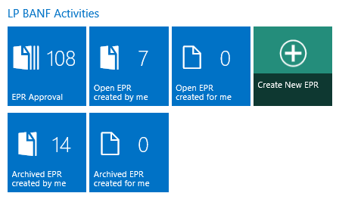

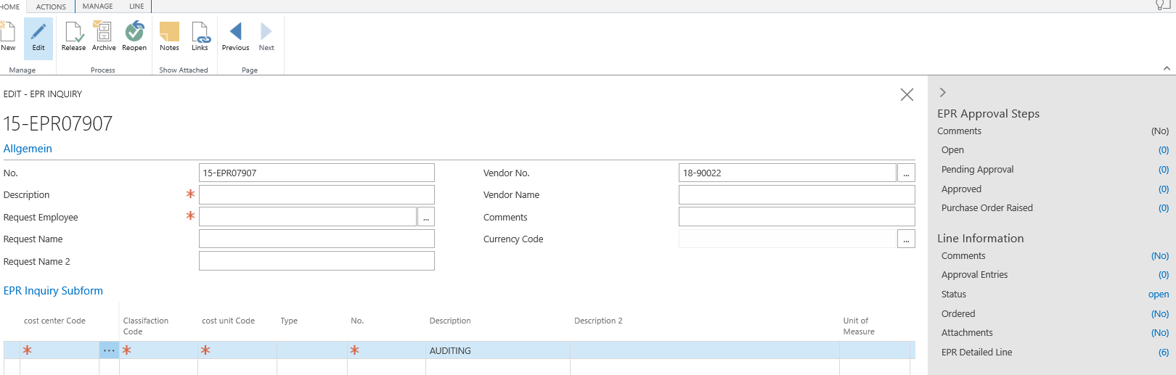
2. How to create EPRs?
Prepare the data you need to set up the EPR i.e. Cost Center, Cost Unit, Item, the amount for which you are setting up the EPR.
After logging into Navision you will see the main menu, you start creating an EPR by clicking Create New EPR:
2. The page should look like the one on the right. You see the EPR number, which will be assigned automatically. In the NO cell. You don't fill in anything, you go to Description.

Slide 6
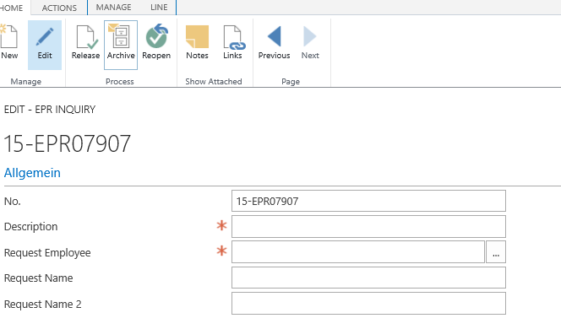
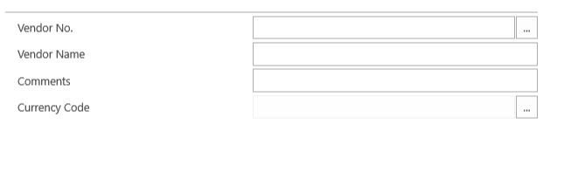

2. How to create EPRs?
3.
Description: enter what you are setting up the EPR for
Request Employee: expand the list of employees by clicking on the highlighted box and select your name, or you can type in your name then expand the ribbon and select 'Last name’.
Request Name i Request Name 2: are filled automatically.
4.
Vendor No.: expand the list of Vendors and select the one you want to set up an EPR on, click on the selected Vendor Name, the field is filled automatically.
You can type the name, click the arrow and then choose Name filter - this way you also search for the Vendor.

Slide 7
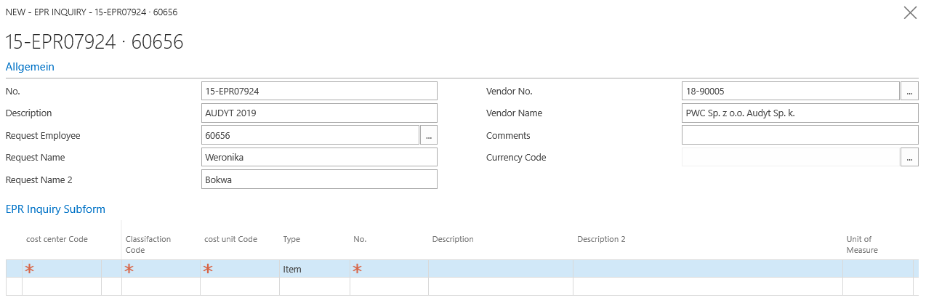
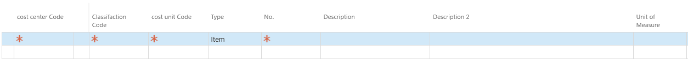
2. How to create EPRs?
5. This is what the correctly completed first part will look like. Let’s move on to the next part.
6.
Cost Center Code: you enter or select from a list, choose yours or for whom you create an order.
Classifaction Code: click on the checked box and select Administration or Services from the list (depending on what you are setting up EPR for).

Slide 8
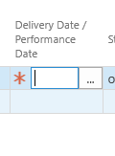

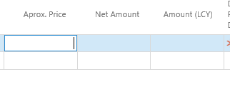
2. How to create EPRs?
7.
Cost Unit Code: expand the list by clicking on the highlighted box and select the appropriate one
Type: this field is filled in automatically, if not then select „Item”.
No: select the number of the Item,
Description i Description 2: these fields are filled automatically
Unit of Measure: click on the highlighted box and select the unit from the list.
8.
Quantity: enter the amount of invoices
Aprox. Price: enter net amount, the other fields: Net Amount i Amount (LCY)are filled automatically
Delivery date/Performance date- future date of service

Slide 9
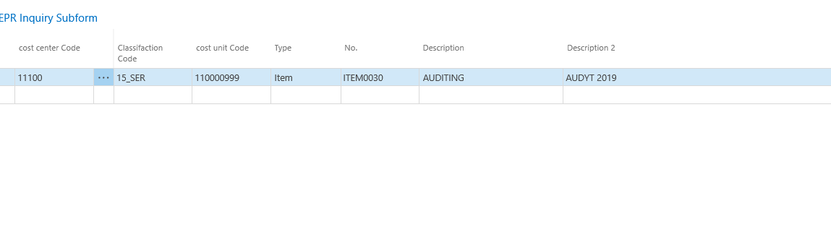
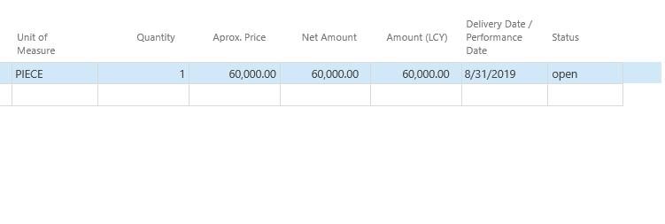
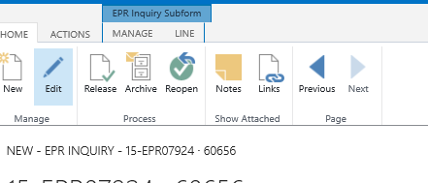
2. How to create EPRs?
Before the EPR is sent for approval, all the fields discussed in the previous slides should be filled in, and the status should be "open." Now it must be sent for approval. You do this by clicking Release.
After clicking "Release," the EPR goes to approval according to the approval path. The status should change from Open to Pending Approval.

Slide 10
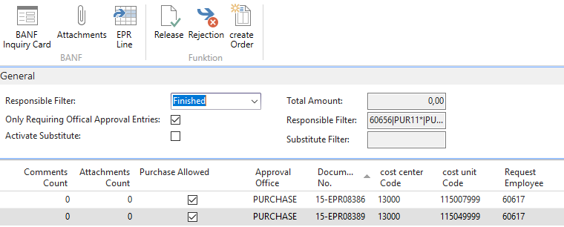
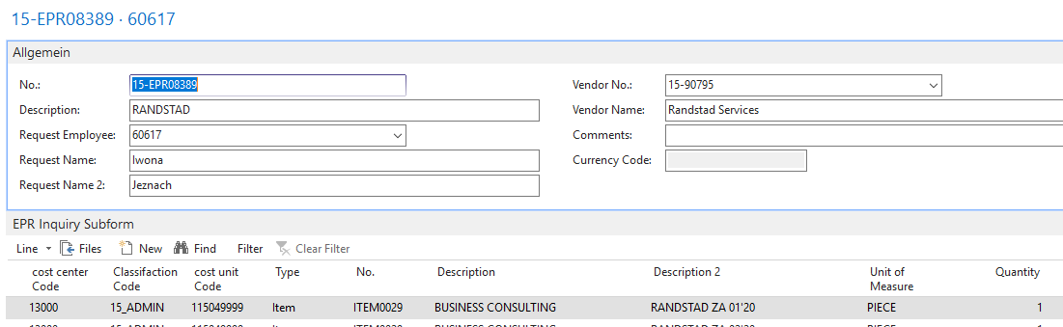

3. MY EPR was rejected, what now?
Once you have set up an EPR, it is best to check its status by logging into Navision, but if any person has rejected the EPR you will be notified by email - this is an automatic message sent from the system. The person who rejects the EPR enters the reason for its rejection, which appears in Navision as well as in the message you receive.This way you know what is wrong and what needs to be corrected. We proceed to correct the data:
1. you find the rejected EPR in Navision, click on it once and then select BANF Inquiry Card,
2. After clicking BANF Inquiry Card you will go to the EPR preview. Here you select Line- highlighted below and then Reopen.

Slide 11
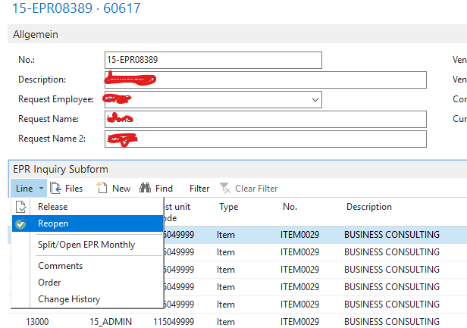
3. MY EPR was rejected, what now?
After clicking Reopen, you can edit any data.
If u changed data that was previously entered incorrectly - Resubmit the EPR for approval by clicking Release.
Check that the status of the EPR has changed and is Pending Approval.
Your EPR will go through the approval path again.

Slide 12
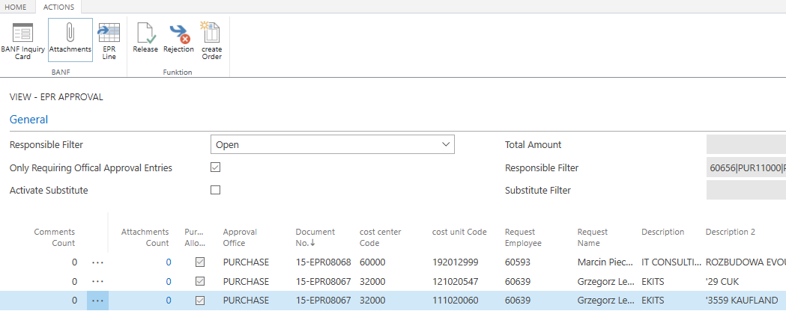
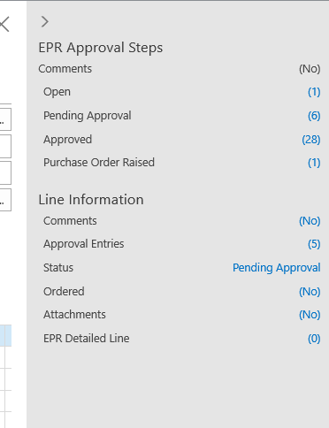
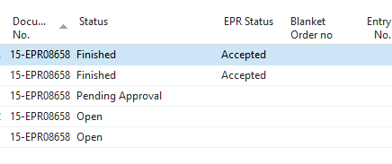
4. How to check the approval path of an EPR?
EPRs that are not yet accepted are in the Open tab. Locate the EPR you want, then highlight it by clicking on it and select BANF Inquiry Card. On the right side you will see an option to check the status, click on Pending Approval.
You will see the names of the people responsible for EPR approvals, next to the name you will see the status "Pending Approval" which means that the EPR is waiting for that person's approval or "Approved" which means that the EPR has been approved by that person.

Slide 13
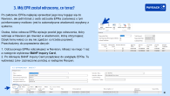
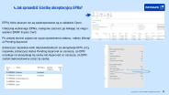


5. How to change data in an EPR that has been sent for approval?
Follow step 3 ☺
6. Who has my EPR ready for approval?
and
7. Is my EPR accepted?
Find the EPR and then follow step 4 ☺
Your EPR has finally been approved if you go into Navision - EPR Approval and it is there!
It is worth knowing that when you go into the details of the EPR it may have a status of:
Rejected - has been rejected,
Pending Approval- is awaiting approval,
Approved- has been accepted.

Slide 14
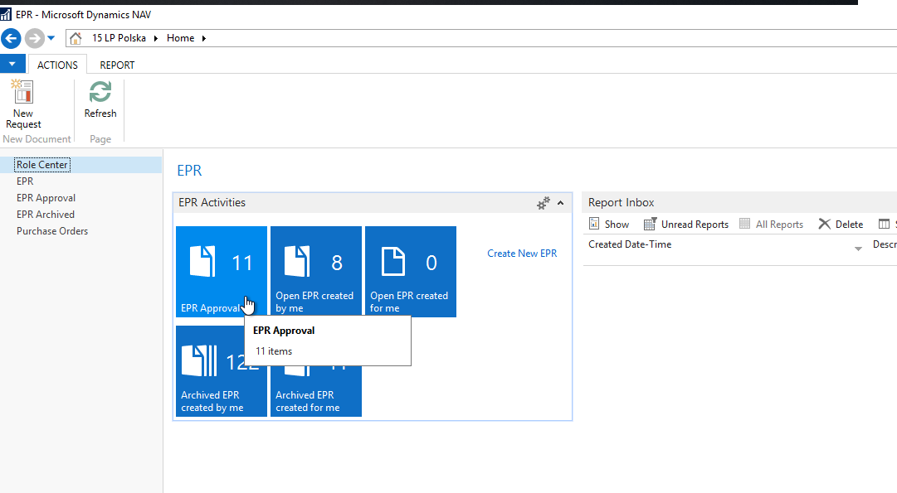
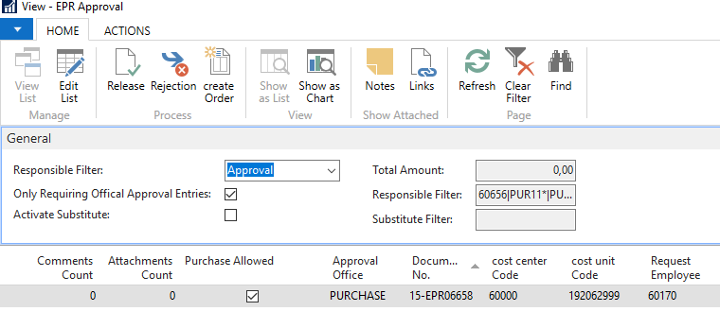

8. How to generate Order and what to do next?
All accepted EPRs can be found in Navision under EPR Approval. Clicking on this will take you to a list of all approved EPRs and there you will create an order.
Select the EPR from which you want to create an order and then click on it.
When it is selected, then at the top of the page click Create Order. Navision will ask if you want to do this- choose Yes.
You have just successfully created the order- Navision will give you the order number. Now put it on the invoice before sending it to faktury@payback.net

