Slide 1
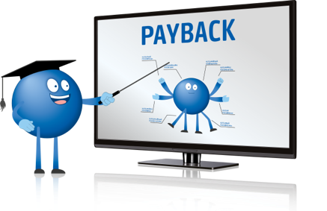
Induction – Finance Department
Accounting
2023

Slide 2

Agenda
1
How to find us?
2
Structure
3
Sales and Receivables
4
Costs and Liabilities
5
All others
6
Dictionary

Slide 3
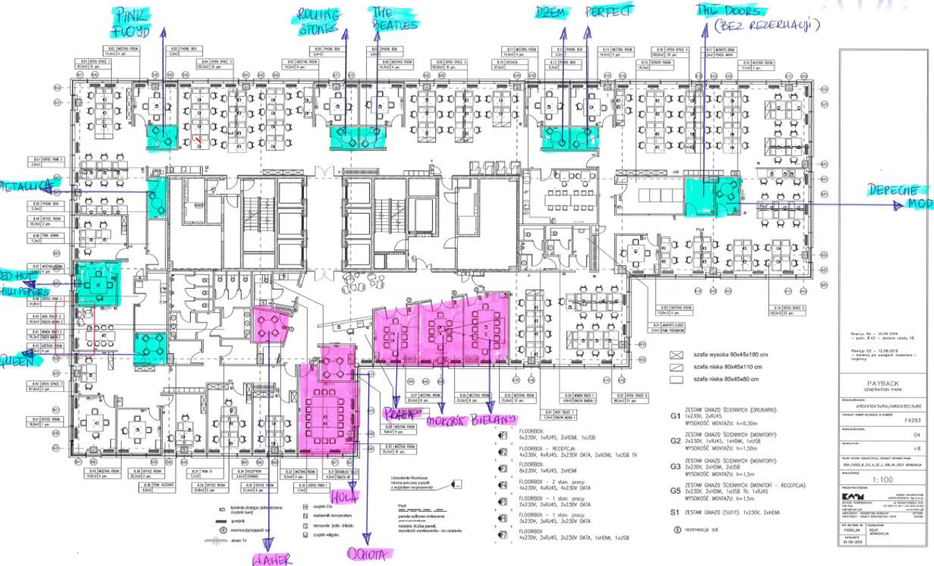
How to find us? Room next to reception desk, faktury@payback.net , korespondencja@net.pl
1

Slide 4

Structure
Finance Team – Accounting
2
Director, Accounting & Reporting
Petros Amanatidis
Accounting Department
Anna Kowalczyk
Iwona Wrońska
Weronika Zabor
Aleksandra Pietrzak
Director, Taxes
Winfried Staeblein

Slide 5
Sales and Receivables.
Where does Accounting get its data from
3
1. Financial Automation Tool (FAT) – File, where PM (Partner Manager) includes data regarding fees/marketing fees for respective month to issue an invoice. Deadline for data is sending each month to all dedicated people. Link below. PM initiates in NAVISION system invoice, then send it for approval and booking. Process is called Manual Invoicing (on basis of FAT data)
Link to the folder with files : FAT
2. Global Platform (International Platform) – specific information regarding circle of points are settled on global platform and after month end, through interfejs, are uploaded to accounting program in desribed configuaration. We register on dedicated accounts: points issued, points redeemed and points expired. Platform allows us to produce very quickly invoices from points area (in sales and purchase sites).
3. Orders – document word/pdf, which confirms ordering services different as indicated in clearing reports and in FAT.

Slide 6
Sales and Receivables.
We confirm service fullfilment
3
All services sold to Partners, which are not mentioned in their contracts or does not result from clearing reports, must be documented by Order.
Order should include:
Date
Information about products sold in particular period
Date of service
Partner data
Order should be sign by Partner (not nessesary according to representation).
Documentation hast to be sent at least till the last of working date of the month.

Slide 7
Sales and Receivables.
New Partner and requirements
3
Implementation the new Partner requires unconditionally informing about that Financial Department and IT Team in order to create Clearing Report for the new Partner and set up this Contractor in our database.
It is releated to filling file – Master Data, Clearing Rules, etc.
For details we invaiting personally.

Slide 8

Costs and Liablities
How does Accounting know to book and pay an invoice?
4
1. Zamówienia usług i towarów odbywa się poprzez zamówienia. EPRy.
EPR - Electronic Purchase Request - system of electronic orders, accepted by responsible for budget people. EPRs are prepared by You in the system called Navision.
If in your responsibilities is ordering services or goods, ask Accounting Team for acces to Navision, and then make an appointment for individual training…or use instruction.
Instruction EPR: INSTRUKCJA_EPR
Exceptions:
There is no need to create EPRs for : redemption, hotel and fly/train tickets and employee expenses – from private account.

Slide 9
Costs and Liablities
When new vendor appears
4
Every new supplier must be checked. Therefore it has to proceeded according to instruction Loyalty Partner Toolbox: TLM_Vendor Onboarding
In this process needed is acces to Makigami (Neula). All actions are required and described there.
Controllership team is informed after completing that in Makigami. Information about closing the ticket for set up a new Vendor including number of this Vendor created in Navision, is delivered through Makigami in the last step of the process.

Slide 10

Costs and Liablities
From EPR to payment
4
Invoices are delivered online faktury@payback.net. Invoice must be in pdf, each in separate e-mail and in the subject of the e-mail must be word Faktura or Fa or Invoice or Inv…etc. On the invoice has to be Order number (Order it is the final stage of EPR after approving it by all approvers).,
So to summarizet stages:
Stage 1 EPR
Stage 2 Order
Stage 3 Sending Order to vendor (number Order to include by Vendor on the invoice)
Stage 4 Invoice send to mailbox faktury@payback. net *
Stage 5 Accept invoice by Cost Center Owner in Easy (document workflow) *
Stage 6 Payment
* Stages between mailbox faktury@payback.net and Easy are proceeded by Accounting Team.
Payments are proceeded according to payment deadline, if it is delivered with Order number at least one day before dute date.

Slide 11
Costs and Liablities
For what is Navision for what Easy
the correctness of the amount
4
EPR’s/Order’s are generated in Navision – it is process dedicated for accepting costs before starting cooperation with Vendor.
Acces for Navision is granted to people involved in purchasing process in dedicated Team, regardless of position (info for Accounting Team).
Instruction Ion Toolbox or and individual training.
At this stage compliance with the budget is checking, as well vendor, way of reconcilation etc.
For approval for payment after receiving the invoice Easy is dedicted. It is consent Cost Center Owner to payment realization.
At this stage delivering service/good, correctnes of amount with the Order, confirmation of real time of delivering is approved.
Instruction Ion Toolbox

Slide 12


Costs and Liablities
Settlement of employee expenses
4
Employee expenses paid from private means are reconcilie in the special format using program Makigami (Neula)
Detailed instruction, how to proceed with expenses, to get payment back, is described on toolbox, in section Financial Settlement.
All pdf documents need to be saved there – copies of invoices, tickets, confirmation etc.
Loyalty Partner Toolbox: reimbursement of costs incurred
Neula - Loyalty Partner
Reimbursement possible only on bank account the employee!

Slide 13

Costs and Liablities
We document non-material services.
4
All non-material services above 10 000 PLN must be prooved by special documentation.
If you order such service you should deliver additional documentation which is required by tax audit. It could be description of the invoice prepared by Contrator, timesheet, presentations, meetings agenda, minutes, report, project…
If you face problem with getting this documentation, problems with interpretation or problem with saving (strange formats of this documentation) please contact Controllership team.
This documentation should be deliveered korespondencja@payback.net after delivering the service (after issuing by them the invoice).

Slide 14
Costs and Liablities
We gain Residence Certyficates
4
Ordering services by foreign Vendors obliges to deliver to Finance Team below documents:
Residence of Certyficates - tax confirmation from tax authorities our contractor
Information about the character of their activity
Signed statement (available on toolbox)
More information on toolbox
Loyalty Partner Toolbox: Certyfikaty Rezydencji Podatkowej
Without mentioned documents, we could not proceed properly, especially we could not pay full (100 %) of amount mentioned on the invoice.

Slide 15

Costs and Liablities
Contest reconcilation
4
If you are planning the competition you should:
    Prepare Regulation together with Legal Team.
    Deliver to Finance Team all documentation needed to conduct the contest.
      Regulation accepted by Partner (at least confirmation in the e-mail)
      Agreement
      Invoices for rewards
      List of winners in the format
      Winner A reward value. ………… date of delivering the reward ……………
      You should remember, that all reward in the contest are taxed.
Note: All competition for Payback employee are taxed in salary list so it means in PIT.

Slide 16

All others
And all what you want to ask I wszystko o co chcecie zapytać
5
Salaries are calculated and prepared by outsorced company – Vistra. All questions please address to HR department – they are our contact with Vistra.
If you did not find answears to your questions, or just you want to come to see us, just to talk….you are welcome.
Ania, Iwona, Weronika, Ola

Slide 17

Dictionary
6
Easy – IT programm for worflow and archive documents. Managed by Accounting and Cost Center Owners.
EPR – Electronic Purchase Request – consent request (service or good) generated in Navision
FAT – Finance Automatization Tool – excel tool for narzędzie excelowe to enter data about Partner’s fees.
Makigami/Neula – program for employee reimburesment and travel expenses. Used by other Teams for agreement approval.
MI – Manual Invoicing – proces where Partner Managers are involved. In the Navision system they initiate invoices for their Partners.
Navision – Accounting programm . For Accoutning - Full version , for EPR creators only Purchase module.
Order – generated in Navision from EPRa after realizing all approval. Last step before ordering services /goods.
Platform Global /International – FDWH where all points transactions are registered on each stage.
Redemption – name of proces exchanging points for rewards.
TLM - Third Party Lifecycle Management Process – checking Vendors/Customers in special database if it is in line with Amex expectations (Toolbox Admin)

