Slide 1



Accepting EPRs
Instructions for those in the approval path

Slide 2

Agenda
1
How to open list of EPRs
2
Approval or Rejection of EPR

Slide 3
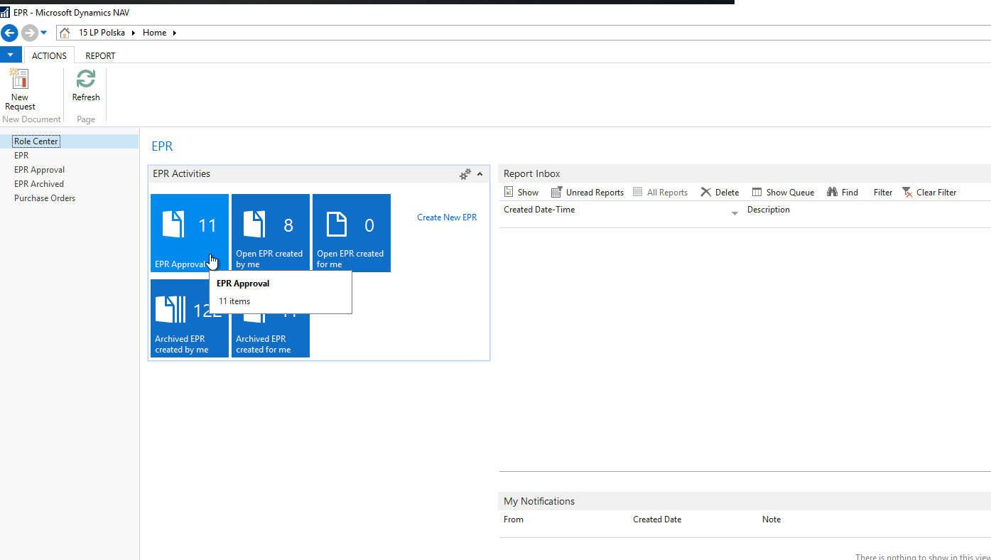
1. How to open list of EPRs
After logging into Navision, select EPR Approval, there you will see a list of EPRs that have gone to your approval.

Slide 4

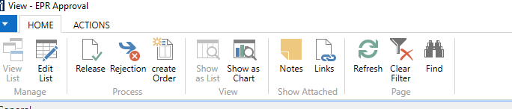
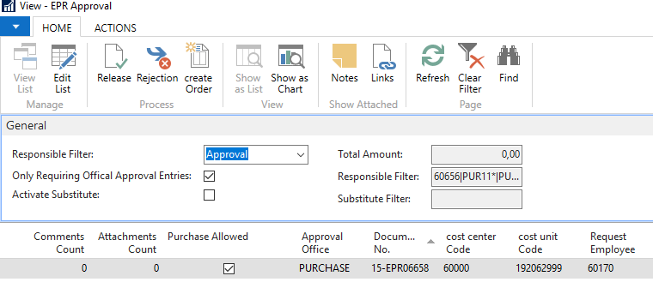
2. Approval or Rejection of EPR
Approval is done by selecting one or more EPRs and clicking Release at the top of the page.
Rejecting an EPR looks the same, but instead of Release you choose Rejection.
If you don't see the EPRs, try changing the "Activate Substitute" by clicking the mouse on the place marked with the arrow.

