Slide 1

Operations Team
Address Management
Customer Service
Campaign Management
Marketing Services / Production

Slide 2



Address Management
Data Validation
Data Cleanup
Data standardization
Data Deduplication (person, address point)
Creating so-called whitelist and blacklist
Enriching letters with personal data (automatic, manual)
Production support for DM campaigns
Robotic Process Automation Project Management
Personally identifiable information (PII):
Personally Identified fiable Information Personal data is any information relating to an identified or identifiable natural person. Individual information which, in combination, may lead to the identification of a person, shall also constitute personal data.
Personal information that Address Manager affects:
postal address
email address
phone
name e.g. mail output files
Marta Herod
Address Manager

Slide 3
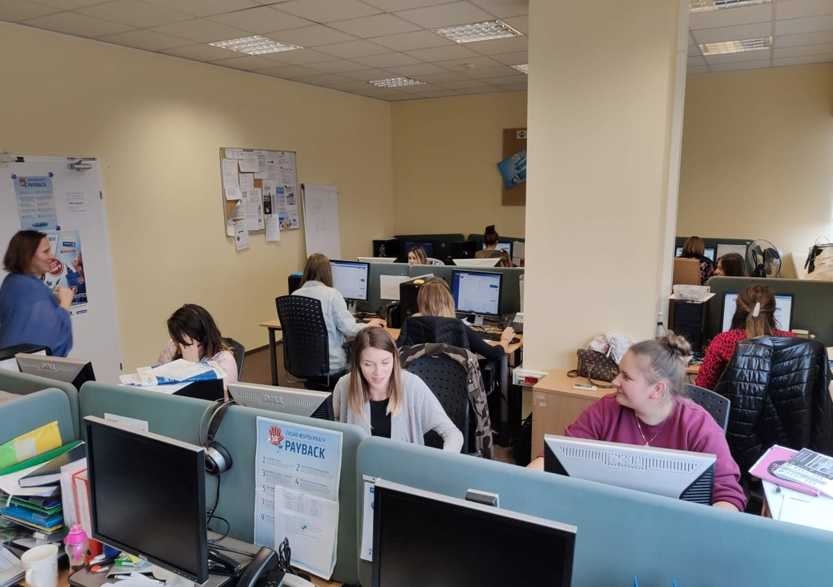

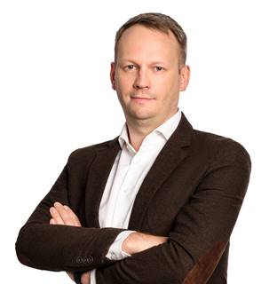
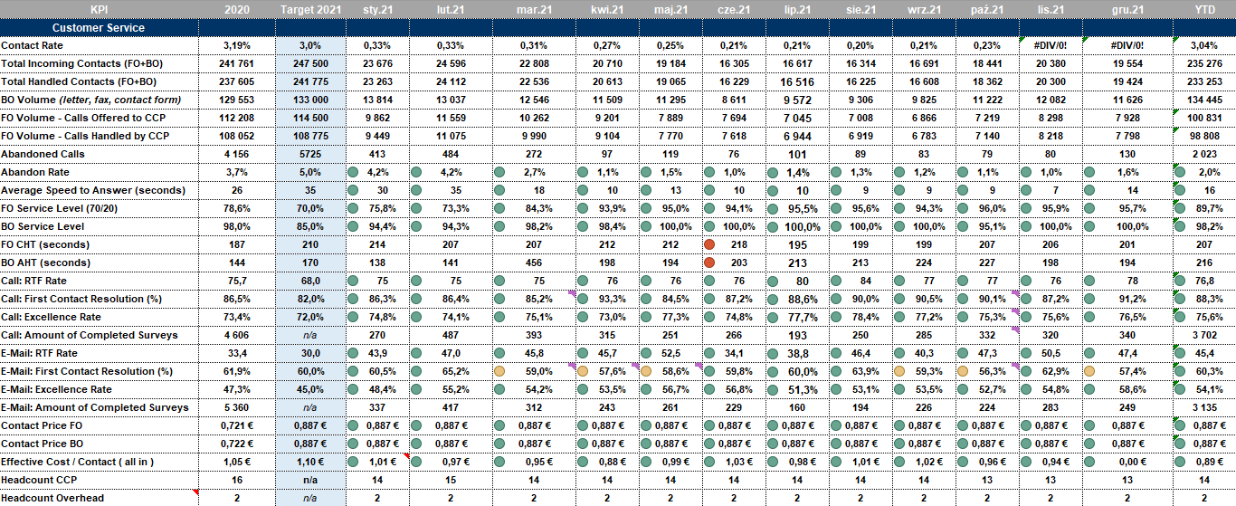
Customer Service
hotline in Rawa Mazowiecka since 2009
5 people in Rawa since 2009!
telephone and e-mail support
      Customer Knowledge Center
Gosia and Bartek - a center of customer knowledge, about complaints, problems etc.
support for general knowledge of the operation of PAYBACK (promotion mechanics, consultation of tender rules, support during the offer building stage)
support in the complaint data and their scope
Customer to LP connector - need to provide quick solutions to customer problems
"Signalists" - often the first to know about problems with PAYBACK
Małgorzata Bozek
Customer Service Manager
Bartosz Rosalski
Customer Service
Operations Specialist

Slide 4




Campaigns
Newsletter & SMS
Campaign Calendar mgmt
HTML programming
Campaigns testing and set up
Triggered Campaigns
Coupons and T@T
Testing and support
Mobile Push
Campaign Calendar mgmt
Testing and set up campaigns
Web and mobile application
Placement calendar mgmt
Content Publishing by CMS
Other:
Process ownership: NL and Coupons (KPI)
Vendor mgmt - Digitree (Sare) and Vercom (Redlink)
TLM
PACE etc
Marketing campaigns execution on the last stage (testing and set up)
Quality assurance to guarantee error-free marketing products in different channels
Marketing support from technical-operational-perspective
Functional/feature consultation
EMAIL and SMS providers mgmt
Taking care of operational and process KPI’s
Katarzyna Pawłowska
Senior Campaign Manager (Team Lead)
Justyna Rylska (Kucharska)
Senior Campaign Specialist
Agnieszka Kacała
Campaign Specialist
Paulina Tatara
Intern

Slide 5





Marketing Services / Production
CCL & eKit PVC Card Manufacturing
Manufacture of selfmailers and other paper marketing materials
Pooling multi partner/PB cards
Manufacture of POS materials for partners
Management of external PL/DE suppliers
Regular data security certification of suppliers (AMEX)
Grzegorz Leśniak
Head of Operations

Slide 6
Thank you!

