Slide 1


Prepare your
Personal Devel o pment
Discussion
& preparation material

Slide 2

Instructions for the employee
It’s a hard work to verbalize your strengths & development needs. Especially regarding your professional development. This process will help you to grasp your thoughts and put them in words.
Please answer both quadrants of questions even if they are somehow redundant.
Notes are mostly for you so please prepare them, but you don’t need to show (all) them if they are very personal. It’s about discussion.
It’s your choice how open you will be with your manager, but my personal experience is that being open helps a lot. And also this process is valuable for your personal development as well.
Keep my fingers crossed to prepare your development plan tailored to your real needs!
Write your development actions!
Making PDP is easy, or?

Slide 3

Example page with stage 1
Verbalize & sharpen your thoughts
Verbalize Development Actions
Identify
strengths & development needs
Identify your expectations
This process will help you verbalize your development actions
What makes
fun & what not

Slide 4
PDP1. Opportunities & limitations in merit work & organization of cooperation
Pros / Strengths
Cons / Areas for improvement
What helps me, what I like, what drives my satisfaction
What disturbs me, what I dislike, what drives my nuts
The merit part of work,
scope of duties, activities, technical skills
Hard - Work
What helps me, what I like, what drives my satisfaction
What disturbs me, what I dislike, what drives my nuts
The human part of work, relationships, contacts, information flow, soft skills
Soft - Cooperation
Based on emnos methodology introduced in 2011

Slide 5
PDP2. Balance of the present & expectations for the future
I wish to have
I don’t want to have
I have and I wish to have (Resources)
I have, but I don’t want to have (Barriers)
I have
I don’t have, but I wish to have (Goals)
I don’t have and I don’t want to have (not(Values))
I don’t have
Based on PAYBACK methodology introduced in 2017

Slide 6
PDP3. Development Frame
My strengths
My areas for improvement
Where I would like to be, what I would like to do in 3 years?

Slide 7
PDP4. Personal Development Plan
Development Action 1
By when? What support I need?
Development Action 2
By when? What support I need?
Development Action 3
By when? What support I need?

Slide 8
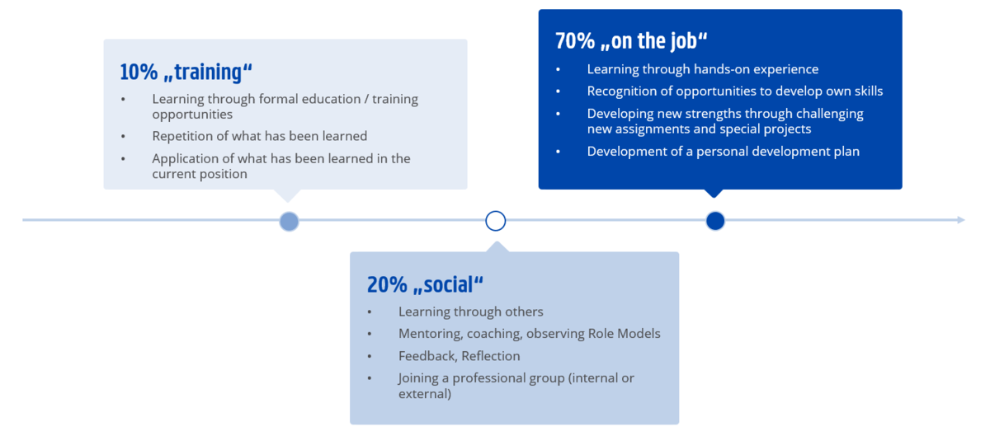
70/20/10 Development from Toolbox

Slide 9

Thank you!
And have a fantastic discussions!

