Slide 1

Employee Capital Plans
in PAYBACK

Slide 2
Employee Capital Plan is…
voluntary, private long-term savings system, automatically available to all employed people aged 18 to 54 (from 55 the employee submits an application for joining the program) who are compulsorily covered by retirement and disability insurance, after the age of 70. accession is impossible
it is created by the Employee, Employer and the State
is obligatory for Employers and voluntary for Employees (they can submit a resignation declaration)
it is a funded system that is not part of the public pension system, therefore the savings on the account are private, fully inheritable, not subject to seizure by bailiffs (except for maintenance obligations) and may be withdrawn at any time
The purpose of establishing Employee Capital Plans (ECP) is to support employees in long-term savings for retirement purposes.
ECP covered 3.3 million Poles in 2019 and 11 million Poles in 2020.

Slide 3
Who is not required to create a ECP?
Pursuant to the PPK Act, its provisions do not apply to:
micro-entrepreneurs, if all employees submit a declaration of resignation from making payments to the ECP
a natural person who employs, to the extent unrelated to its business activity, a natural person, to the extent not related to the business activity of that person (i.e. people employing babysitters or occasional domestic help)
an employer who runs Employee Pension Plans (PPE) in which at least 25% of employees participate and calculates and pays basic contributions in the amount of at least 3.5% of remuneration.

Slide 4
Who and when does the ECP include?
since 1 July 2019 – companies employing at least 250 people as of December 31, 2018,
since 1 January 2020 r. – companies employing at least 50 people as of June 30, 2019, (PAYBACK)
Anti-crisis Shield, which entered into force on March 31 2020 changed the deadlines for implementing the ECP.
Act on the so-called The new applicable deadlines for us are:
27 October 2020 ─ for the conclusion of a ECP management contract,
November 10, 2020 ─ for the conclusion of the ECP management contract.
from July 1, 2020 - companies employing at least 20 people as of December 31, 2019,
from 1 January 2021 - other entities and units belonging to the public finance sector, regardless of how many people they employ.

Slide 5
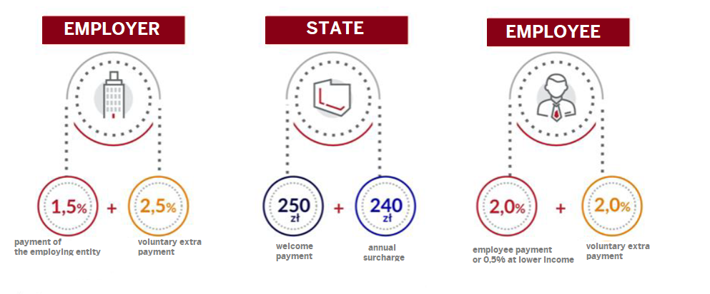
Who and how much will pay?

Slide 6
Who will pay and how much?
Employee - 2% basic contribution plus voluntary contribution up to 2%
Employer - 1.5% basic contribution plus voluntary contribution up to 2.5%
State - welcome payment of PLN 250.00 (it will be received by every employee who will be a participant of the PPK for at least 3 full months and on whose account of the PPK will be made basic payments financed by him for a period of at least 3 months) plus an annual surcharge of PLN 240.00 (it will be received by every employee, provided that the amount of basic and additional contributions financed by the employer and the employee in a given calendar year is at least the amount of basic contributions due on the amount constituting 6 times the minimum remuneration applicable that year.
Example:
the minimum salary in 2019 was PLN 2,250.00. This means that the right to the additional payment will be granted to a PPK participant whose account will receive the amount of PLN 472.20 (6x2.250x3.5%)

Slide 7
How is it counted?
The basis for calculating the contributions is the employee's gross salary, i.e. the base salary (under the contract) plus other benefits that constitute the basis for calculating the contributions for compulsory retirement and disability insurance, e.g. bonuses, awards, income from using a company car for private purposes, functional allowance, P2E ( with the proviso that the limit of 30 times does not apply, payments are deducted from the total remuneration)
In Enova, you can check your gross income by going to the Employee Dashboard - Financial data - Payouts - Annual payroll card
The employee pays tax on the employer's contribution in the amount of 17% or 32% depending on the threshold in which he is located (32% of the excess over PLN 85,528.00)
Contributions financed by the Treasury are exempt from personal income tax

Slide 8
How is it counted?
Example:
gross remuneration: PLN 5,000.00
employee's contribution 2% = PLN 100.00
employer's contribution 1.5% = PLN 75.00
the employer's contribution tax (17%) = PLN 13.00
deductions: PLN 113.00
net: PLN 3,500.19
monthly savings: PLN 175.00
savings in ECP after 1 year with state subsidies: PLN 2,590.00
Check how much you will save:
https://www.mojeppk.pl/kalkulator.html

Slide 9
How it works?
For those employed, who will save in ECP, individual accounts will be created, which will be fed with monthly payments of employers and employees as well as a welcome payment and annual subsidies from the state.
Contributions to the ECP will have to be calculated by the employer on all components of the remuneration constituting the basis for the assessment of contributions of a given person, without limitation to 30 times the basis of assessment.
All payments will be made by the 15th of the month following the month in which they were calculated and collected
The employer will choose one of the financial institutions that will invest the funds collected in the accounts in various financial instruments.
Savings will be invested in funds taking into account the age of a given PPK participant - these are the so-called defined date funds.

Slide 10
What are Defined Date Funds?
The rules for investing savings are described in detail in the Act in relation to the age of the ECP participant:
Investment limits:
Łączna wartość inwestycji w aktywa denominowane w walutach obcych nie będzie mogła przekroczyć 30% wartości aktywów funduszu.
 | Share part - refers to assets invested in equity instruments, e.g. shares, subscription rights or participation units of collective investment institutions | Debt part - these are assets invested in debt instruments, e.g. bonds, treasury bills, mortgage bonds, certificates of deposit or other transferable securities.
from Fund start to 20 years under 60 year of life | 60–80% | 20–40%
20 years under 60 year of life | 40–70% | 30–60%
10 years under 60 year of life | 25–50% | 50–75%
5 year under 60 year of life | 10–30% | 70–90%
Achivement of 60 year of life | max. 15% | min. 85%

Slide 11
Who and how will invest in investment funds?
Only Financial Institutions managed by entities entered in the ECP register kept by the Polish Development Fund and meeting the following conditions participate in the ECP system:
at least 3 years of experience in managing open-ended investment funds, pension funds or open-ended pension funds, and in the case of insurance companies - at least 3 years of experience in offering insurance with an insurance capital fund;
have equity, and in the case of insurance companies - admitted own funds of at least PLN 25 million, including at least PLN 10 million in liquid funds;
manage the appropriate number of funds or sub-funds of a defined date.

Slide 12
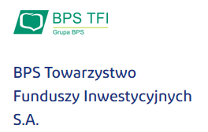

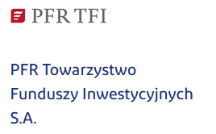

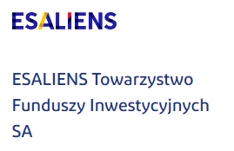
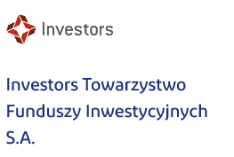



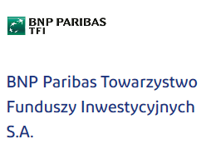

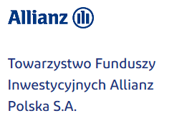
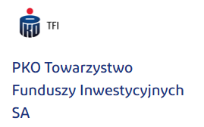
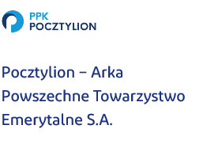
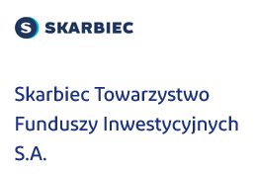
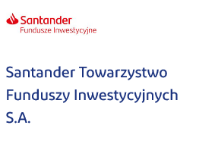

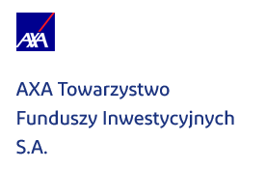
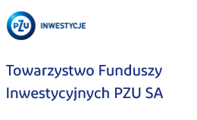

20 financial institutions on the Portal ECP

Slide 13
Who will take care of the security of funds in ECP?
Supervision of financial institutions in terms of compliance with the law will be exercised
Polish Financial Supervision Authority
Managing entities must meet a number of statutory requirements to be allowed to manage funds accumulated in the ECP. Your savings in the ECP can only be managed by an institution that has the appropriate experience and resources described in the Act.
Accumulated funds will be invested in defined date funds whose investment policy as you approach your age
up to 60 years of age will automatically change in such a way as to reduce the level of investment risk.

Slide 14
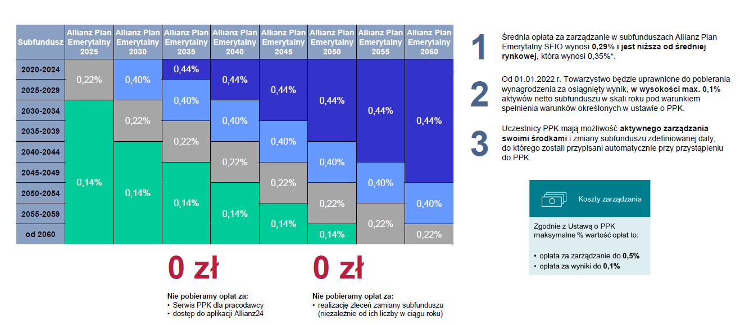
8 subfunds defined dates set aside under the Allianz (Retirement Plan) Plan Emerytalny SFIO
1. Average management cost
in subfunds is 0,29% and its
lower than market average
(0,35%)
2. Starting from January 1, 2022,
the Society will be entitled
to receive remuneration for
the achieved result,
in the amount not exceeding
0.1% of the Subfund’s
Net Asset Value per annum,
in accordance with the principles
set out in ECP act
3. ECP Participants have a
opportunity to active
management their sources and
to change defined date subfund
to which they
were assigned autmatically
Management costs:
according to ECP act max % cost is:
- management cost to 0,5%
- resluts costs to 0,1%
WE DO NOT CHARGE FEES:
ECP Service for Employer
Accesss to Allianz24 App
execution of fund change orders (regardless of their number in a year)

Slide 15
When can the accumulated savings be withdrawn?
After the age of 60, 25% once, and 75% in at least 120 installments and for a minimum of 10 years (reducing the number of installments in which the remaining funds will be disbursed - including the payment of the entire amount at once, will require you to pay tax or 100 % as a transfer payment to the insurance company for periodic or lifetime benefits or 100% as part of a marriage benefit in at least 120 monthly installments if one of the spouses has also reached the age of 60 and has PPK in the same Financial Institution
Earlier - in the event of: serious illness of you, your spouse or child (up to 25% of funds with no obligation to return)
And to cover your own contribution, if you take a loan for an apartment or house construction (for people under 45, up to 100% of funds with the obligation to return within a maximum of 15 years) only once
Or at any time, by submitting an application for a refund, but then the accumulated savings will be reduced by: capital gains tax, 30% of funds from contributions by the employer - the 30% collected is saved to the employee as his pension insurance contribution in ZUS, funds from subsidies from the Stat

Slide 16
Benefits for employees
Access to funds - funds collected in the PPK can be withdrawn at any time. However, it will involve, inter alia, with the loss of tax benefits and state subsidies.
Earlier withdrawal with tax benefits - in special situations, it is possible to withdraw funds without losing tax benefits. In the event of a serious illness, up to 25% of the accumulated funds can be withdrawn.
Payment for the purchase of an apartment - in the case of buying a house or apartment, you can withdraw up to 100% of the funds, with the need to return within 15 years
Protection of relatives - savings collected in the PPK will be private and inherited without inheritance tax

Slide 17
Can you give up saving in EPC?
It is possible to opt out of saving in the EPC by submitting a declaration of resignation from making payments to the EPC and related benefits, such as e.g. payments from the Employer or additional payments from the State.
You can resign from participation in the EPC both at the stage of creating the program and at any time in the future.
Contributions financed by the Employer constitute the Employee's taxable income, the Employer will be obliged to deduct the tax on these contributions from the Employee's salary.
Every 4 years, the employer will again be obliged to make payments for employees who previously submitted a resignation declaration. The first deadline for the automatic resumption of deposits is April 1, 2023

Slide 18

More information…
https://www.mojeppk.pl/

Slide 19
Q&A
Feel free to ask any questions ☺

Slide 20

Thank You for Your attention!
PAYBACK
Iwona Jeznach
HR Specialist
Phone 103
Phone +48 519-066-840

