Slide 1
Antitrust – Information for employees

Slide 2


Gesetz gegen Wettbewerbsbeschränkung ("GWB")-
The "Constitution of free Market Economy"
GWB §1 Prohibition of agreements restricting competition:
Agreements between undertakings, decisions by associations of undertakings and concerted practices which have as their object or effect the prevention, restriction or distortion of competition are prohibited.
When several companies
coordinate their
behaviour on the market in
order to restrict or eliminate
competition, this is known
as a cartel.
Even the exchange of strategic
information between
competitors is considered
a violation of antitrust law.
For the assessment under
antitrust law it is in principle
irrelevant whether the coordination
and exchange takes place directly
between the competitors or
indirectly via a third party.

Slide 3



Antitrust law aims to protect secret and free competition
The pressure of competition leads companies to lower their prices and improve the quality of their products and services or develop them further.
The ultimate aim is to secure benefits for consumers.

Slide 4







Competing Companies must not coordinate their behaviour or exchange strategically relevant information
Competing Companies = Overlaps in the range of goods

Slide 5


Exchange or transfer of information: allowed or not allowed?
publicly available -aggregated -
bilateral -
PAYBACK Programm -
secret
partner-specific
strategic
competition-relevant

Slide 6

Nicht erlaubt!
Agreements and the exchange of information between competitors are inadmissible
under antitrust law, in particular, on...
... Prices, price components, planned price changes,
...discounts, incentive levels,
...suppliers and delivery conditions,
...partner-specific initiatives related to PAYBACK
...corporate strategies, market behaviour and partner roadmap,
...new product launches,
...type, number and identity of own customers,
...technological initiatives not related to PAYBACK,
...planned marketing campaigns and
...sales or turnover figures.
Regardless of antitrust law, a great deal of information may not be passed on due to existing confidentiality agreements. If this is not applicable on certain information, you must check whether it might be questionable under antitrust law to pass on the information!
Any information can still be discussed bilaterally with a partner himself, but no sensitive information from a competitor may be disclosed!

Slide 7

Pricing and marketing activities
Price agreements are not permitted, including agreements on "price components", i.e. discounts (= incentives)
Examples of this include cross-partner marketing campaigns such as
"5x points week" or "gold points" - these are no longer possible
Disclosure of information on planned stand-alone marketing activities of a partner is not permitted
A competitor could adapt its market behaviour accordingly
Examples include stand-alone mailings, special newsletters, inserts in PÜ/PSM, Facebook campaigns

Slide 8


Nicht erlaubt!
The exchange of information is permitted under antitrust law, e.g. about...
...general economic data,
...industry developments,
...legal and political framework,
...general economic developments.
In principle, information on individual partner companies may be communicated if it is already publicly known, i.e. freely available on the market.
It is also permitted to disclose aggregated key figures that do not allow conclusions to be drawn about partner-specific information.
The exchange of key figures on the development of the PAYBACK programme as a whole and on planned further developments of the PAYBACK programme is also permitted from an antitrust point of view, especially when it concerns cross-partner products (e.g. introduction of the PAYBACK App / PAY).

Slide 9


Practical examples from committee work (1/3)
MarketingCampaigns
Period
participation
  Exchange on the preferred campaign period
  Statements on reasons for preferred campaign periods (e.g. partner's own actions)
  After a predetermined deadline (point of no return), information on participation and sending layouts with logos of the participating Partner, if without incentive
  Information on participation before point of no return
Format
  Exchange on the general campaign idea, key visuals and mechanics
  Recommendation of incentive levels and specification of a low minimum incentive (e.g. 5x)
  Comments on planned own, individual incentive levels (bilateral)
  Coordination of a uniform / common incentive level (e.g. 5-fold, Olympics)
  Setting a maximum incentive

Slide 10

Practical examples from committee work (2/3)
A competitor could adapt its market behaviour accordingly
PLAnned ProjeCTS
Best Practices
  Information on planned strategic initiatives of a partner (e.g. Online-expansion)
  Roadmap planning - rejection with reasons (partner plans other (internal) project, PAYBACK ties in new partner)
  Information on new PAYBACK programme functionalities (e.g. new features in PAYBACK App)
  and general development of the programme
  Exchange of key figures on marketing actions and their evaluation, which allow conclusions to be drawn as to whether similar actions are planned again
  Exchange on what went generally well or badly in projects/actions
  Exchange on which qualitative measures have generally increased penetration (without stating how high the increase was)
  Exchanges on planned projects and best practices should be checked in advance for their strategic relevance, as there is no clear legal standard for this.

Slide 11
Practical examples from committee work (3/3)
Competitor could adapt their base incentive accordingly
KPI's
Partnerfreigaben
  Communication of a planned change in the basic incentive
  Communication of partner-specific key figures of marketing campaigns (e.g. response rates, additional sales, penetration, average-bon amount, frequency, cross usage)
  Communication of partner-specific key figures without strategic relevance (e.g. store checks)
  Communication of program key figures or aggregated key figures that do not allow conclusions to be drawn about individual partners (e.g. key figures from the advisory board report)
  Communication of publicly available company information
  Statements on the amount of the planned basic incentive
  Information on the range of the planned point volume
  Statements on the planned commencement date from which it is necessary for the preparation in the committees
  Statements on the minimum share of the incentivised product portfolio in the partner's total product portfolio

Slide 12

The consequences of infringements of antitrust law are serious
In the event of an antitrust violation, very high fines of up to 10 % of the turnover of the group of companies concerned are possible.
Under German antitrust law, fines can also be imposed on natural persons.
Another serious factor is the loss of image and trust that antitrust proceedings cause in the public eye.
In order to uncover prohibited conduct, the Bundeskartellamt may, among other things, conduct searches.

Slide 13






Annual Reviews of the Bundeskartellamt...!
2019:
848 Mio. Euro Fines against 23 companies/associations and
12 natural Persons
2018:
376 Mio. Euro Fines against 18 companies/associations and
10 natural Persons
2020
349 Mio. Euro Fines against
22 companies/associations and
20 natural Persons

Slide 14


Everyone is responsible!
The management ensures that all employees are familiar with the requirements of antitrust law.
Each employee is responsible for compliance with the applicable antitrust regulations, i.e. any conduct that deliberately violates antitrust law has personal consequences. In this context, the disclosure, but not the mere knowledge, of sensitive information is problematic.
In addition, all employees are requested to report concerns regarding conduct or violations of antitrust law directly to the Legal Department. The Legal Department will be happy to provide guidance.

Slide 15
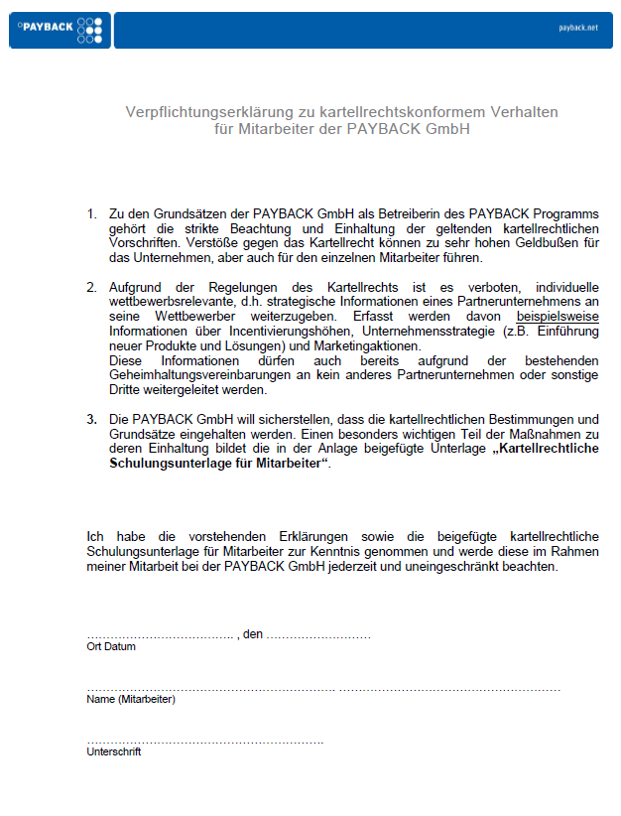

All employees commit themselves to conduct in compliance with antitrust law

Slide 16
Keep your eyes peeled!

